Slide 1
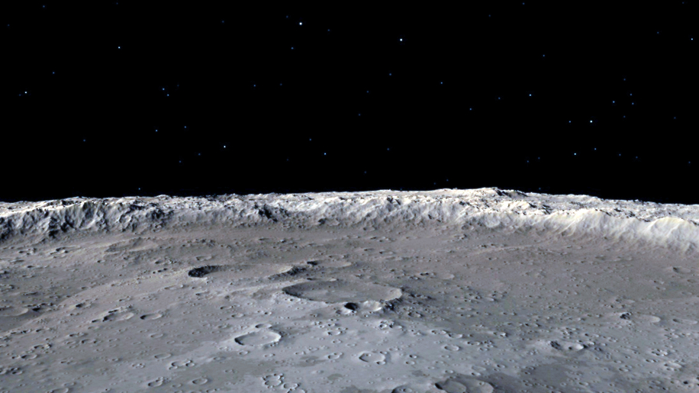

HSML Schema Updates
How to create our own private schema using schema.org
Alicia Sanjurjo Barrio (349B – Affiliate)
12/1/2024

Slide 2

Summary of Updates
Completed the HSML ontology types inside the context file
Published in Dropbox the HSML context file hsml.jsonld (temporary solution).
So, the link to be used in the json files for context is now: https://www.dropbox.com/scl/fi/fxyex9ndqp05316jyfexn/hsml.jsonld?rlkey=tmsoqgidjcfe4f4oa736tisfr&st=rp7c8dp3&dl=0
Simple test of publishing a hsml json file through my own Kafka Server (using Docker), and another test with python for json files and context.
Revised and updated the custom properties for each type
Research on Decentralized Identifiers and how to assure security in our server following the Spatial Web guidelines.
Create examples that follow this schema extension
Notes:
Google Drive direct link is not directly usable by JSON-LD parsers, but Dropbox’s direct file link

Slide 3
Safety and Trustworthiness in the Spatial Web
“A verifiable and trusted identity is an essential necessity to enable the interactions, transactions, and transportation between people, places, or things.”
“Distributed Ledger Technologies enable a world where every identity, contract, transaction, and currency can be trusted and verified.”
“To register the identity of any user, space, or asset on the SW, an individual or organization must first create an account and request a globally unique “decentralized identifier” (DID) based on W3C Standards.”
René, G., & Mapes, D. (2019). The Spatial Web.

Slide 4
Safety and Trustworthiness in the Spatial Web
“Safety & Trustworthiness in the Spatial Web is enabled by Governance”
The main concepts for Governance are:
Credentials – used for authentication and identity – who can access a domain, and how can they interact with it
Norms – act as a principle of conduct or right action over domains
Contracts – binding agreement used to dictate activities and relationships among domains
4 aspects of trust between parties intermediated by digital technologies:
Authenticity – SWIDs (unique identifier)
Integrity
Confidentiality – HSTP
Privacy – Design principle

Slide 5
Credentials in Kafka
Verifying credentials, identities, and access rights requires a combination of cryptographic techniques, authentication protocols, and access control mechanisms.
Credential Verification, Domain Identity, and Access Control in Kafka:
Issue Decentralized Identifiers (DIDs) for producers, consumers, and brokers.
Use Verifiable Credentials (VCs) to grant roles like "producer" or "consumer" for specific topics.
Authenticate users using DID-Auth (challenge-response).
Check role-based access for producers/consumers.
Use encryption and signing for message confidentiality and integrity.

Slide 6
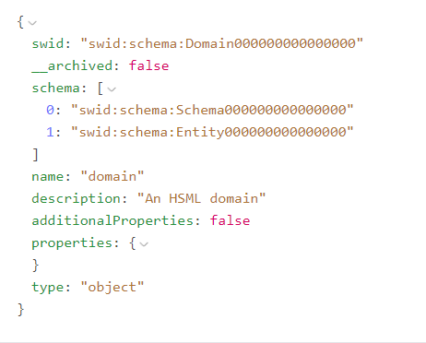
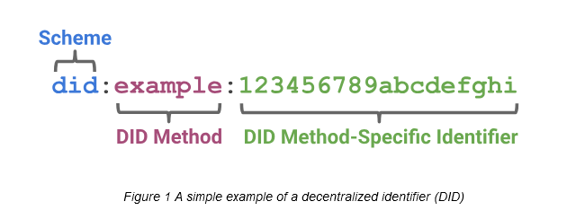
SWID and DID
The Identifier for the HSML schema, according to the Spatial Web standard, is the SWID. The Spatial Web Identifier (SWID) is a Decentralized Identity (DID) that conforms to W3C did-core, https://www.w3.org/TR/did-core/.
NO EXISTING SWID METHOD
USE AN EXISTING DID METHOD
Notes:
However,

Slide 7
DID Methods
The most used DID methods to generate the unique identifier are:
did:key
did:web
did:ethr
The unique identifier is generated through a cryptographic process, this makes it impossible to guess the underlying key or DID
Notes:
The unique identifier is generated through a cryptographic process, this makes it impossible to guess the underlying key or DID

Slide 8
DID Methods
Criteria | DID:ETHR | DID:WEB | DID:KEY
Privacy | Medium – Transactions are on a public Ethereum ledger, but can use zk-SNARKs for privacy. | Low – Relies on centralized control of DNS or domain hosting. | Low – No on-chain record, but depends on how keys are handled.
Easiness to Implement | Medium – Requires an Ethereum wallet and knowledge of smart contracts. | Easy – Requires ownership of a domain name and a simple JSON file hosted at a URL. | Easy – Purely key-based, no blockchain required.
Storage Needed | High – Stores state on Ethereum, costly for large datasets. | Medium – DID document is stored in a simple JSON file on the domain's web server. | Low – No storage required as it’s entirely key-based.
Notes:
The unique identifier is generated through a cryptographic process, this makes it impossible to guess the underlying key or DID

Slide 9
DID Methods
Primary Choice:
did:key
Reason: It’s fast, lightweight, and doesn’t require hosting a website or interacting with a blockchain. No domain registration, no storage, and no costs.
How this would work with Kafka:
To create a DID – use app or a CLI tool (can build a CLI tool with python)
Tool generates a key pair (public + private key)
Creates DID from the public key (like did:key:xyz123)
Your private key stays secret, and the DID becomes your public identifier
Notes:
The unique identifier is generated through a cryptographic process, this makes it impossible to guess the underlying key or DID

Slide 10
Next Actions
Finish including all the custom properties of each HSML type inside the hsml.jsonld context file
Test with Jared the new context
Set up Server inside of JPL Network
Research Use Cases, data to be exchanged and simulation environments used
Implement one of the DID methods

Slide 11
ADDITIONAL SLIDES

Slide 12

Spatial Web Ontology Entries
ENTITIES are the base items used across the Spatial Web in HSML
The Spatial Web ontology defines several classes. All classes are types of the Entity base class:
ACTIVITY
AGENT
CONTRACT
CHANNEL
CREDENTIAL
DOMAIN
HYPERSPACE/SPACE
TIME
HSML encodes ENTITIES in a format, e.g., JSON-LD

Slide 13
Agent has goals, senses, and responds, i.e. Lunar Rover
AGENT
Agent is a type of Domain. Agents can also sense other Domains
Activity is an action performed by an Agent
Agent can send messages through
the Channel
i.e. Lander, Rover, Moon surface
A Domain info can be sent through the Channel
CHANNEL
Channel contains messages related to an Activity
i.e. Leave the Lander
DOMAIN
ACTIVITY
A Domain can perform an Activity.
An Activity can be performed on a Domain
Domain references a Hyperspace
A Credential is made by a Domain (domain authority)
A Contract is done for an Activity
Activities take Time to be carried out
A Credential parties to a Contract
CREDENTIAL
CONTRACT
HYPERSPACE
TIME
Notes:
HYPERSPACE: A set of ‘points’ such that, for every ordered pair of points, there is a possibly empty set of ‘paths’ from the first point to the second, and such that there is an ‘identity’ path from every point to itself. Syn: SPACE.

Slide 14
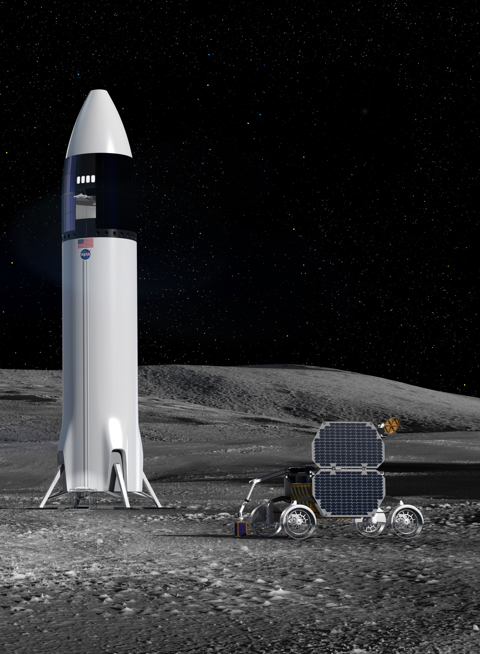
USE CASE:
Two Organizations, Company A and Company B, sign a Contract to work together on a space mission to the Moon.
The Rover of Comp. A will be carried inside the Lander of Comp. B. (Agents)
Once they reach the Moon, the Rover will leave the Lander. To make sure this Activity is developed without any problem, Comp. B needs to work with the model of the Lunar Rover and run some simulations.
A Credential is issued by Comp. A, authorizing Comp. B users (Person) to have access to the 3D Model of their rover for a Period of 3 Months (Time).
The model of the Lunar Rover is in Unreal, and the model of the Lander is in Omniverse; both have a Moon surface environment modelled. The Hyperspace must consider, the location (the Moon), and the appropriate coordinate systems and transforms needed to go from one platform to the other.
All the messages and communications related to this Activity are carried out in a Channel.

Slide 15
Organization: Company A
Channel: Communication between Comp A & B for Activity 1
Organization: Company B
Person: User 1
Person: User 2
Agent: Unreal Lunar Rover 3D Model
Agent: Omniverse Lunar Lander 3D Model
Activity 1: Leave the Lander
Credential: Ownership by Comp. A
Contract: Between Comp. A & B for Activity
Credential: Ownership by Comp. B
Credential: For Comp. B to use temporally Lunar Rover
Hyperspace: Moon, Coordinate System, Transform Unreal-Omniverse
USE CASE
Time: Period of 3 Months
Time: Activity Duration

Slide 16
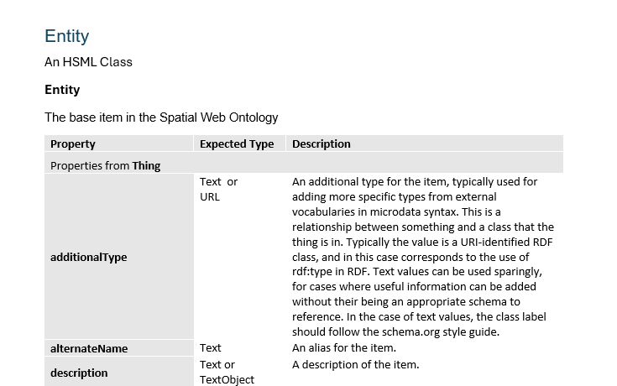
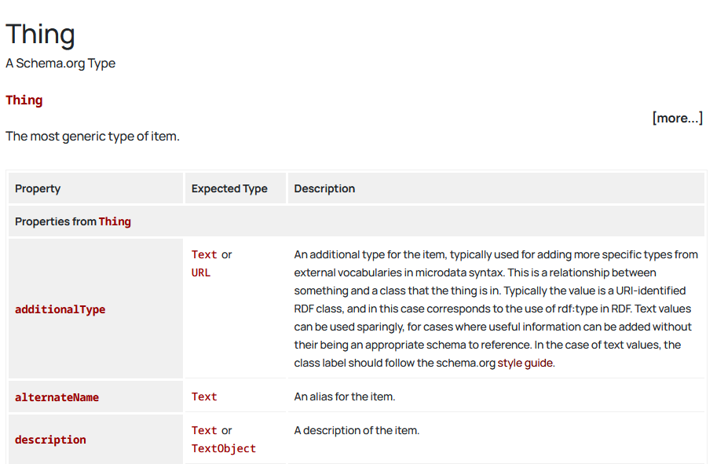
HSML Types Structure
Document currently under construction
Schema.org webpage

Slide 17
Spatial Web Safety and Security
“Safety & Trustworthiness in the Spatial Web is enabled by Governance”
Credentials, Norms & Contracts are the main concepts for Governance
Credentials – used for authentication and identity – who can access a domain, and how can they interact with it
Norms – act as a principle of conduct or right action over domains
Contracts – binding agreement used to dictate activities and relationships among domains
4 aspects of trust between parties intermediated by digital technologies:
Authenticity – SWIDs (unique identifier)
Integrity
Confidentiality – HSTP
Privacy – Design principle

Slide 18
Credentials in Kafka
Verifying credentials, identities, and access rights requires a combination of cryptographic techniques, authentication protocols, and access control mechanisms.
Credential Verification: Use VCs, DIDs, JWTs or ACLs.
Domain Identity: Use DIDs.
User Access Control: Check ACLs, DID VCs, or JWT tokens.
Domain Capabilities: Check DID Documents, VCs, or API responses
Credential Verification, Domain Identity, and Access Control in Kafka:
Issue Decentralized Identifiers (DIDs) for producers, consumers, and brokers.
Use Verifiable Credentials (VCs) to grant roles like "producer" or "consumer" for specific topics.
Authenticate users using DID-Auth (challenge-response).
Check role-based access for producers/consumers.
Use encryption and signing for message confidentiality and integrity.

Slide 19
SWID – DID (Decentralized Identifier)
The Spatial Web Identifier (SWID) is a Decentralized Identity (DID), so it does not rely on central authorities, it is a self-sovereign identity.
The unique identifier is generated through a cryptographic process, this makes it impossible to guess the underlying key or DID
How this would work with Kafka:
To create a DID – use app or a CLI tool (can build a CLI tool with python)
Tool generates a key pair (public + private key)
Creates DID from the public key (like did:key:xyz123)
Your private key stays secret, and the DID becomes your public identifier

